Slide 1
Kentucky Farmland Transition Initiative – Year One
June 5, 2025
Interim Joint Committee on Agriculture

Slide 2
Loss of Farmland in Kentucky
In the last 20 years, Kentucky lost 1.4 million acres of farmland.
For the first time, farmland in Kentucky has fallen below 50% of the land area in the state.
In just the last 5 years, Kentucky lost over half a million acres or 4% of our farmland.
At this rate, the number of Kentucky’s farmers will be cut in half in the next 60 years.

Slide 3
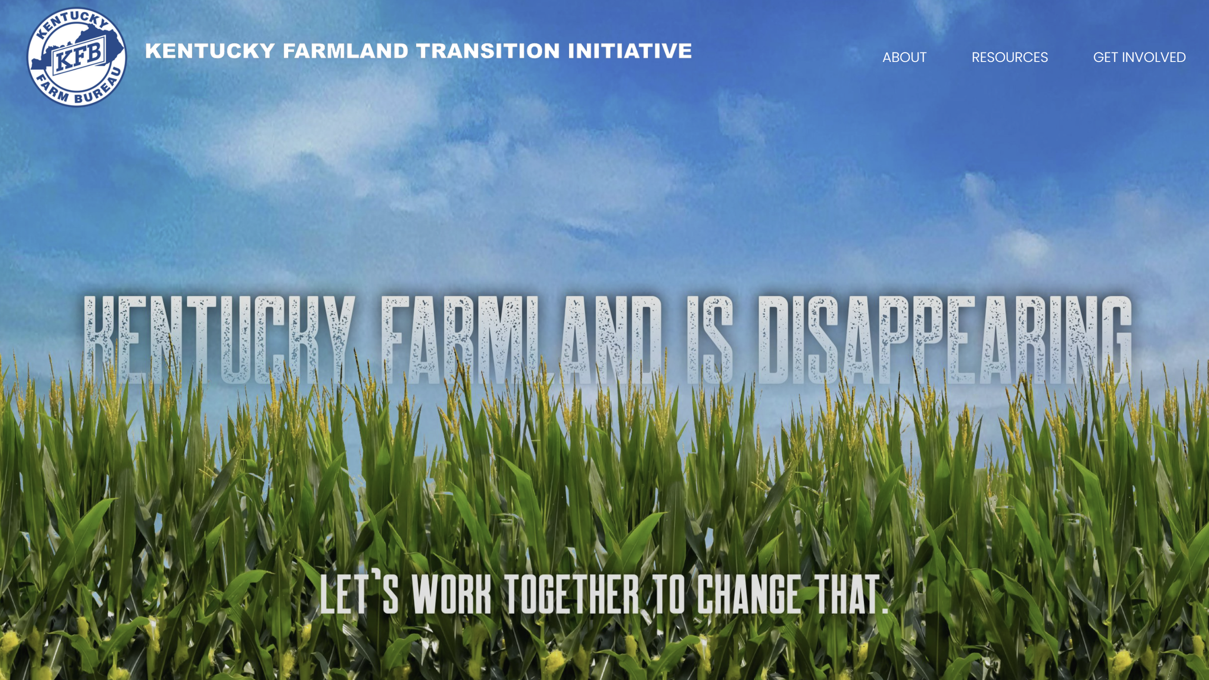
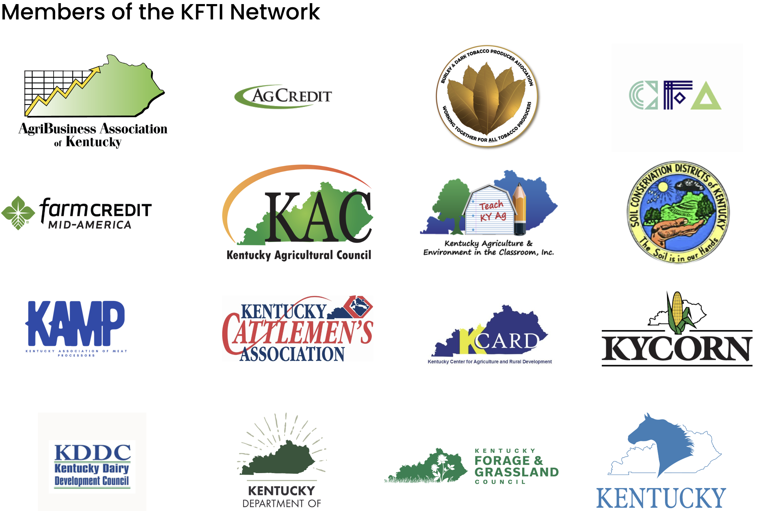
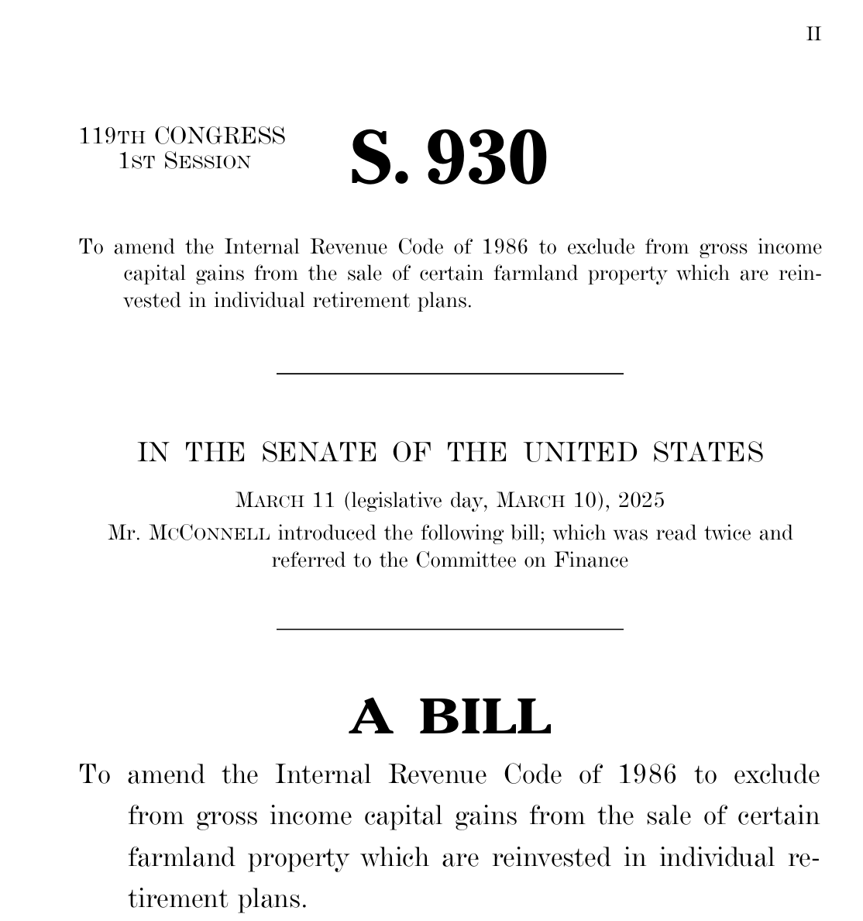
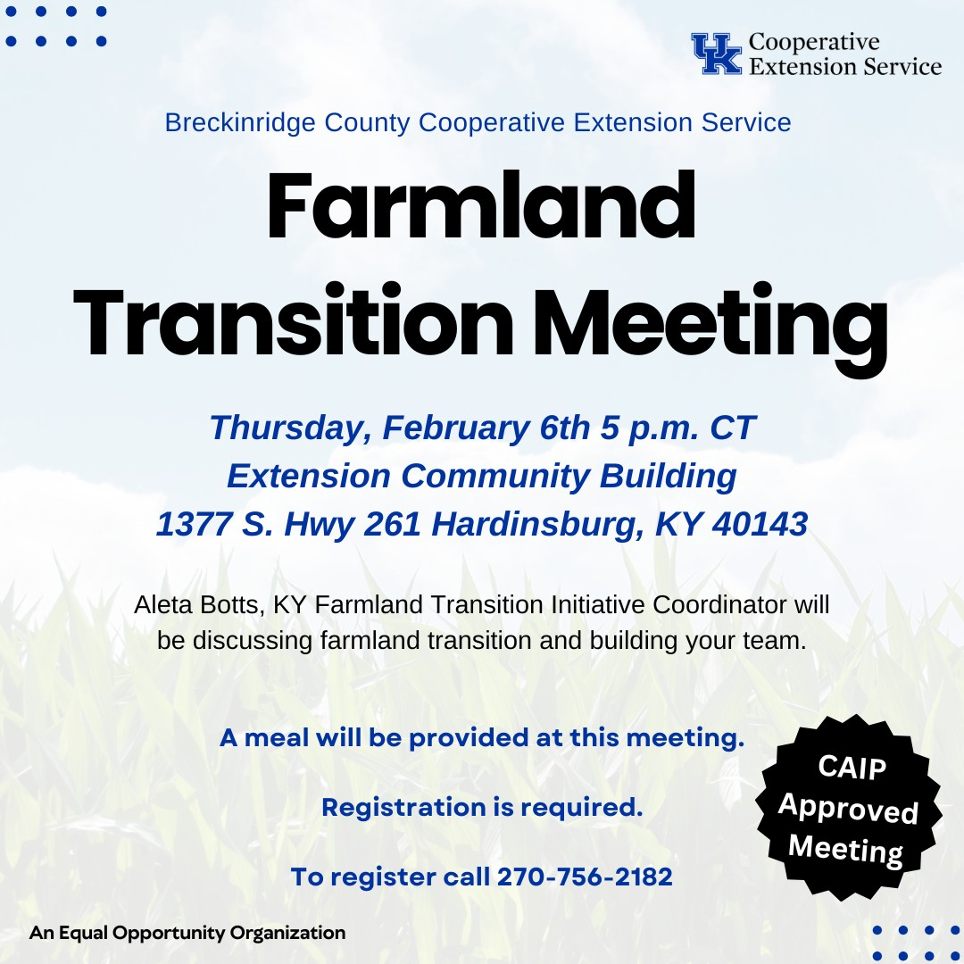
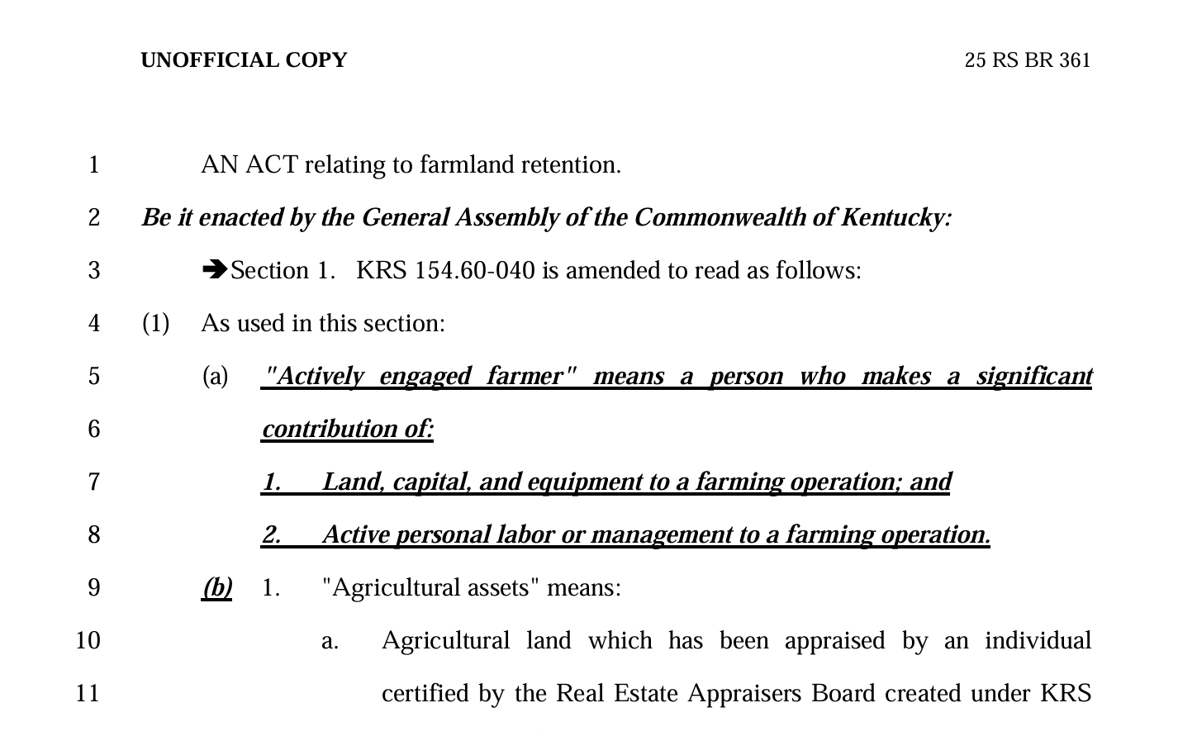
Launch of Kentucky Farmland Transition Initiative
Educate and Inform
Connect
Review Policy
Legal
Accounting
Estate Planning
Business
Mediation

Slide 4
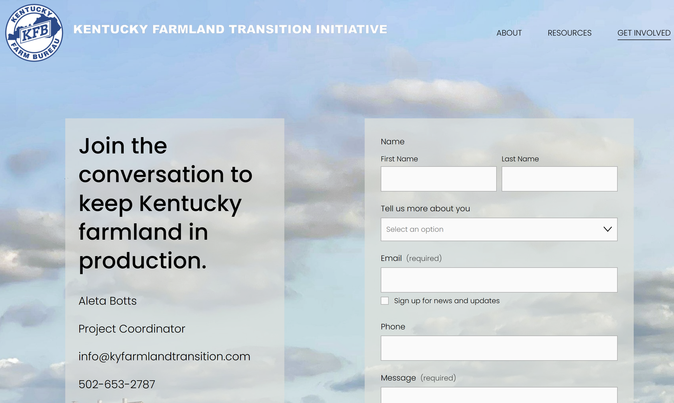
Educate and Inform
Over 5,000 people reached via website.
Over 125 people requested and receiving resources and referrals.
Over 3,600 people attended meetings, workshops, etc.
Website (kyfarmlandtransition.com) was launched to:
Share information on the problem.
Provide resources to help.
Offer an opportunity for the public to engage.
Resources on site include:
Guides and workbooks for farmers and landowners.
Materials for those working with farmers and landowners.
Contact form to provide input and seek help.

Slide 5
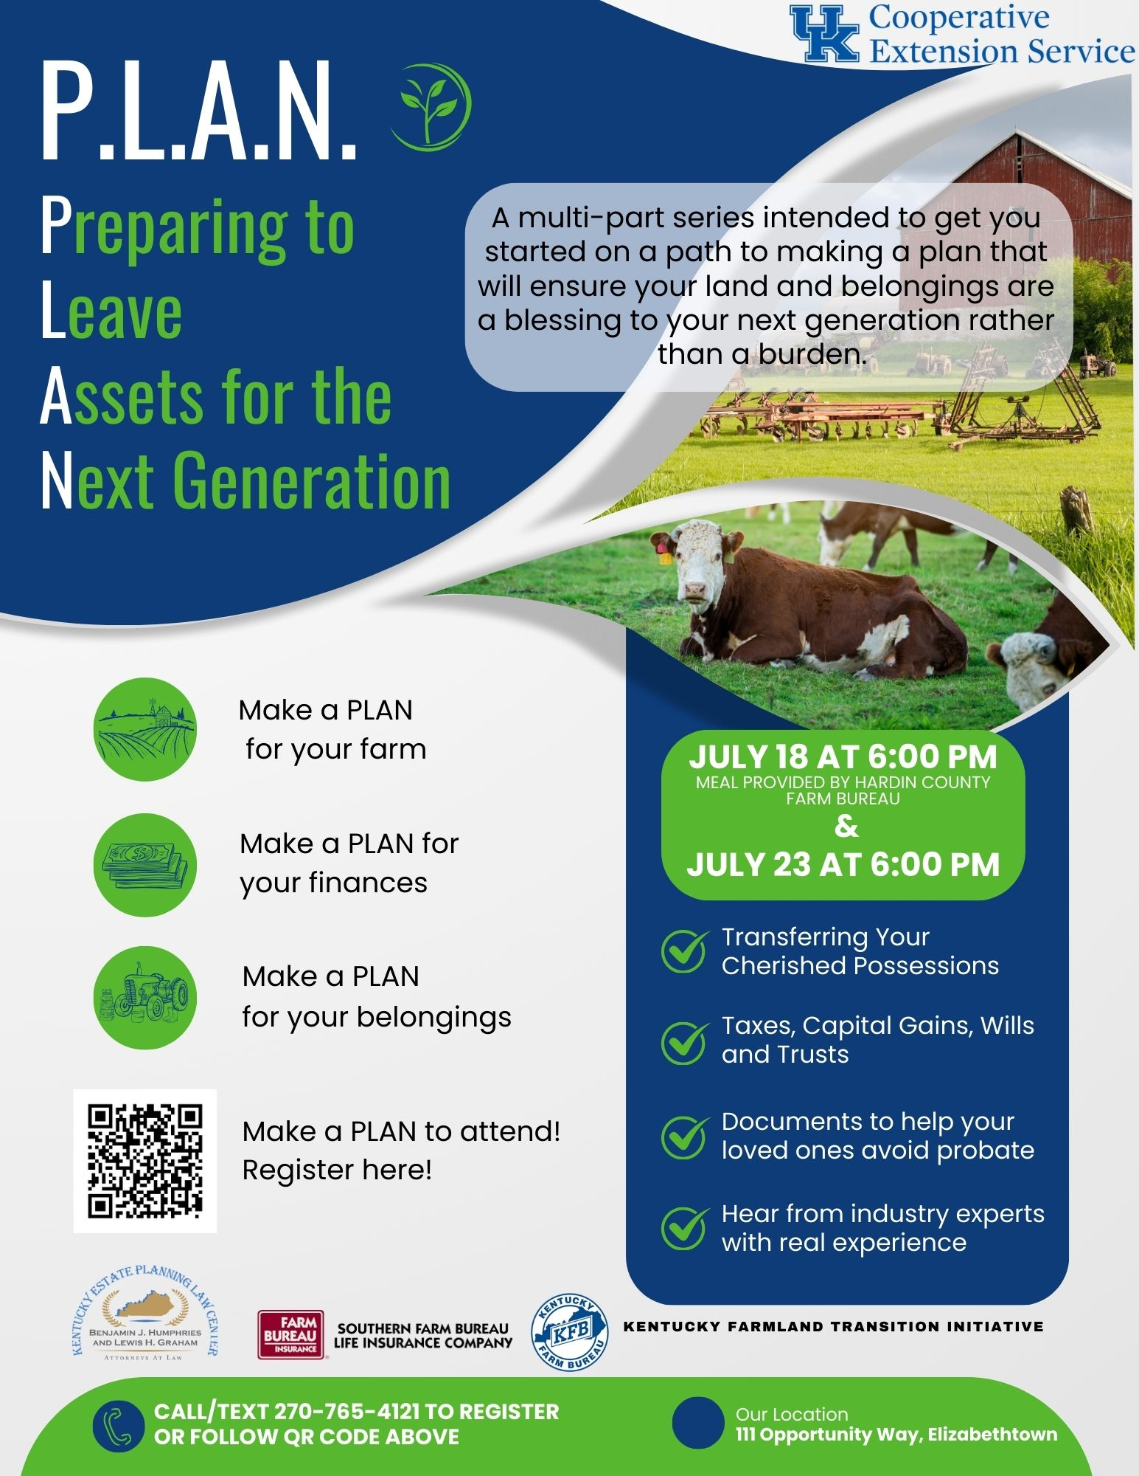
KFTI Efforts Around the State

Slide 6
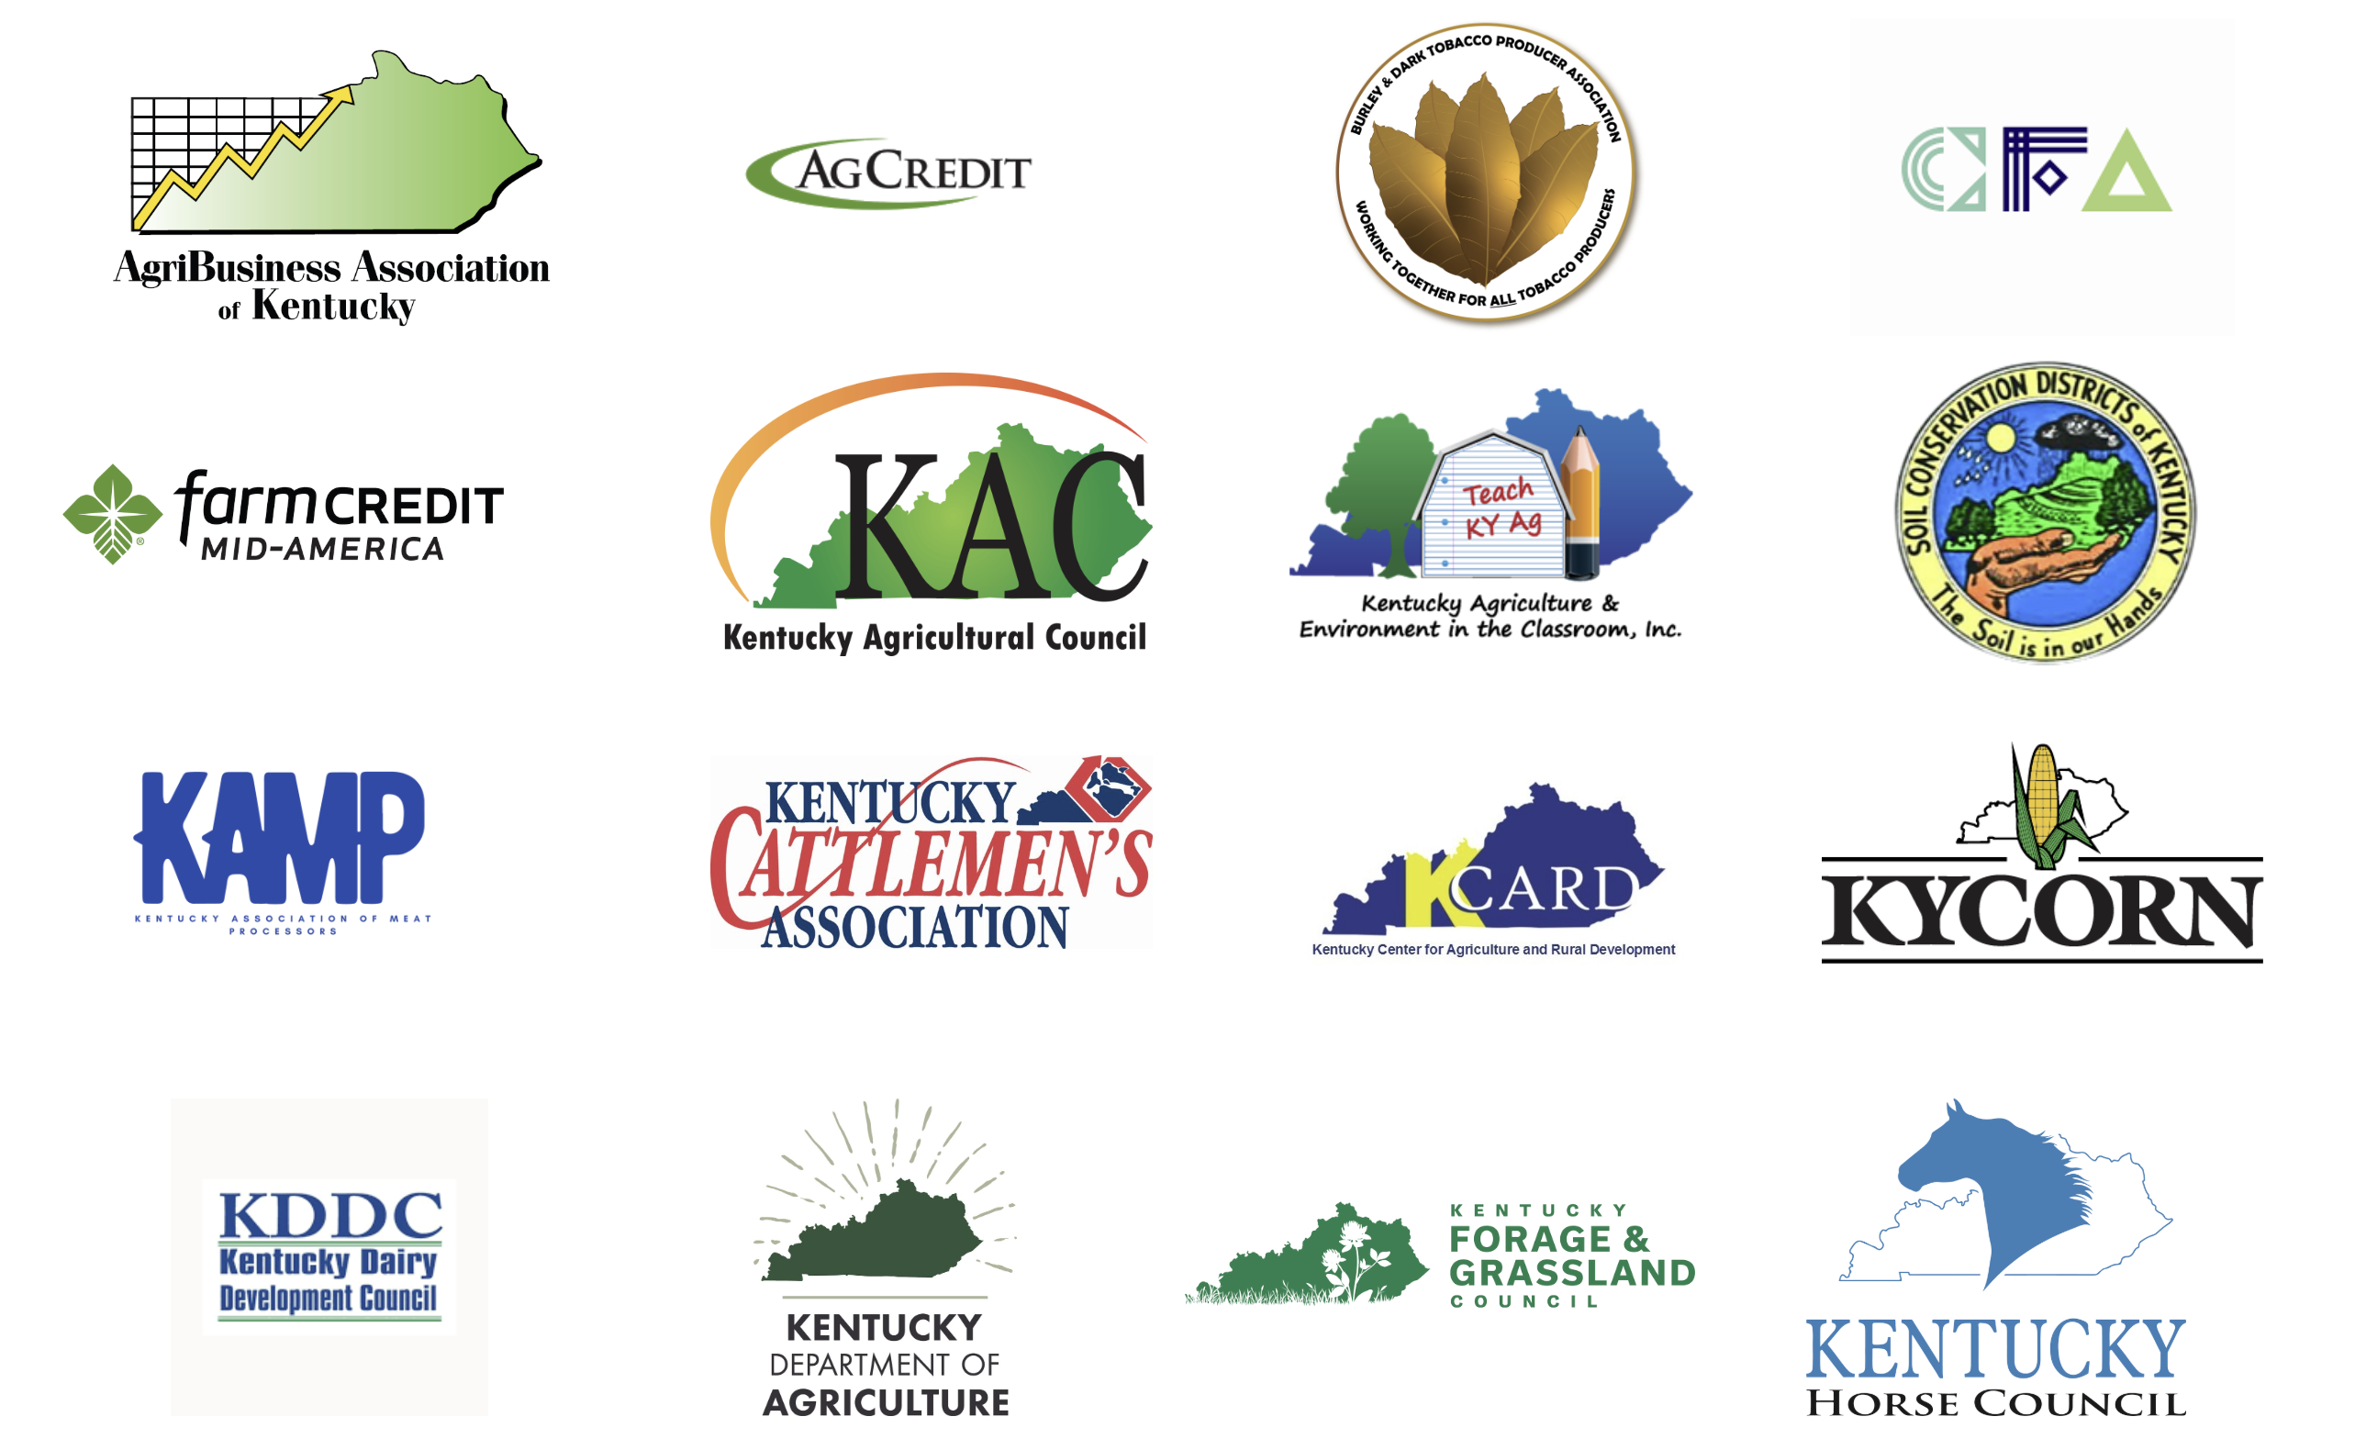
Connect
Established the KFTI Network with 28 Members
Connected with attorneys, CPAs, estate planners, business advisors, and other experts.

Slide 7
Review Policy
Introduction of HB 703 by Chairman Dossett to update the Kentucky Selling Farmer Tax Credit. Enacted as part of HB 775.
Allows all active farmers to benefit from the incentive to keep land in production.
Allows credits to be preapproved prior to sale.
Increases the tax credit to $50,000 for land sold to a beginning farmer.

Slide 8
Review Policy
Introduction of S. 930 by Senator McConnell to create a federal incentive to keep land in the hands of active farmers:
Gives retiring farmers more control over the taxes from sale of farmland.
Gives active farmers a leg up on the purchase of land.
Provides tax benefits that a retiring farmer would receive anyway in their estates but makes available those benefits during their lifetime.
Reduces the challenge farmers face of being “asset rich and cash poor”.

Slide 9
KFTI – The Next Stage
Provide more tailored data and content.
Consider more ways to expand the tools available for families.
Work with stakeholders to make sure the issue of farmland loss is considered.

Slide 10
The Challenge
70% of farmland will change hands in the next two decades.
Only 20% of family farms survive the transfer to the 2nd generation.
As more demands are placed on our land, how can we help farms stay in the hands of active farmers?

Slide 11
Thank you for your efforts to work together to keep farmland in the hands of active farmers.

