Slide 1
Interim Joint Committee on Agriculture
November 3, 2022
COMMUNITY FARM ALLIANCE
37 Years of Change From The Ground Up!
www.cfaky.org

Slide 2
Community Farm Alliance:
Farm is the Foundation for Growth
Presented by: Jennifer Weeber, Kimmie Ishmael, and Martin Richards
Notes:
Martin intros

Slide 3
Investment Grows Eastern Kentucky Food System

Slide 4
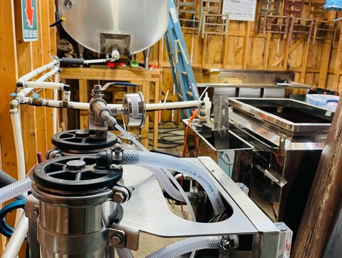
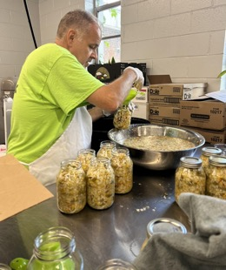
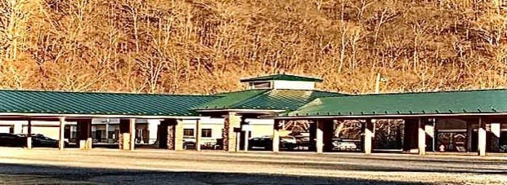
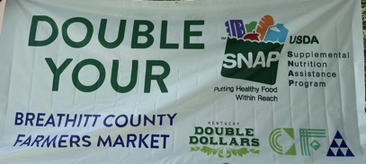
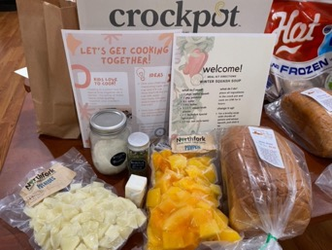
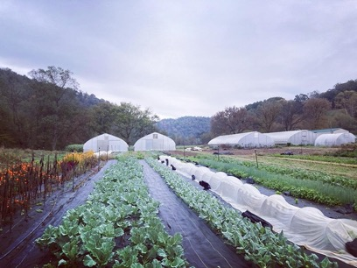
$30 million+ in Federal, State, Local, & Private Investments
Clockwise from top left:
Sugar shack at SouthDown Farm; Letcher County
Making chow chow at CANE Kitchen; Whitesburg
Pikeville Farmers Market pavilion
Healthy food access at Breathitt County Farmers Market
Old Homeplace Farm; Clay County
Meal kit made with minimally processed, local produce; Perry County

Slide 5
Flood Impacts on
Eastern Kentucky

Slide 6
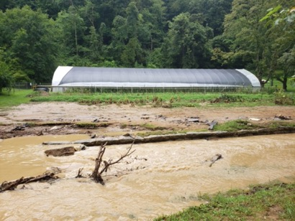
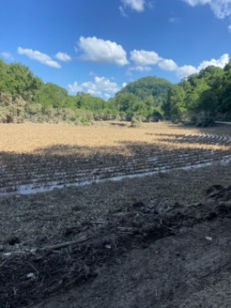
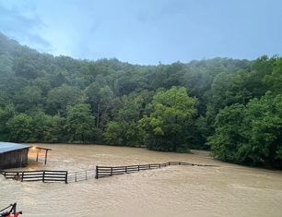
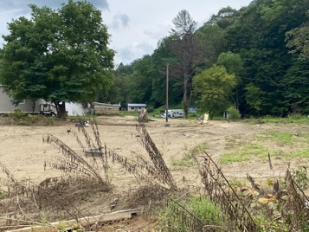
Flood Impact: $3.2 million in damages & $1.3 million in lost income
(as reported by 140 applicants to the Central Appalachian Family Farm Fund)
Clockwise from top left:
Knott County Farmers Market pavilion
Rocket Farms; Letcher County
Hensley Farm; Clay County
Bullmare Farms; Magoffin County
The Adams Family Garden; Knott County
Hurt Farms; Perry County
Back Farms; Breathitt County

Slide 7
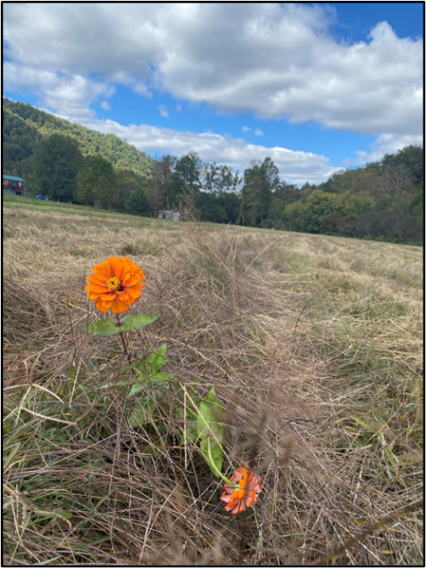
Collaborative Human Capital = Effective, Timely Response
Central Appalachian Family Farm Fund:
Collaboration of the Foundation for Appalachian Kentucky & Community Farm Alliance
140 applications
$354,000 awarded to 94 farms in 10 impacted counties
Equipment Repair & Refurbishment:
Facilitated by the Kentucky Horticulture Council (KHC) in collaboration with other
Will utilize small engine repair classrooms to repair/refurbish small farming equipment damaged in flood
East Kentucky Canning Coalition:
Facilitate by Grow Appalachia, Community Farm Alliance, Northfork Local Food, and local farmers markets
Connecting home gardeners with replacement produce and canning supplies to be able to put back for the winter
Other activities:
Soil and water testing led by Grow Appalachia & KHC
Online Food + Ag Recovery Resources Guide
(Second Chance Homestead; Perry County - Two months after the flood)
https://express.adobe.com/page/Xllnpn1RG1MQI/

Slide 8
Hunger and Nutrition in Kentucky

Slide 9
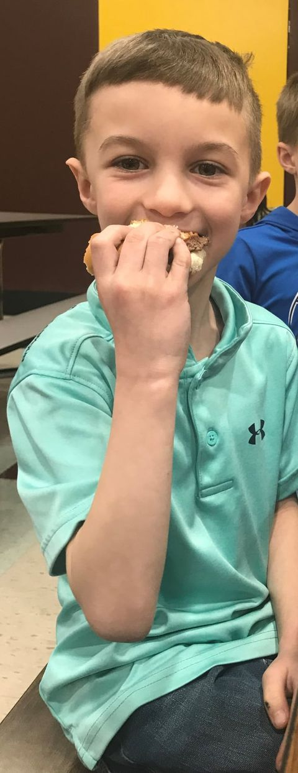
SOLVING HUNGER
TODAY,
In Kentucky, 575,300 people are facing hunger - and of them 162,100 are children.
17.7% of seniors (ages 60+) are food insecure in KY.
1 in 6 children face hunger.
People facing hunger in Kentucky are estimated to report needing $258,458,000 more per year to meet their food needs.
ENDING HUNGER
TOMORROW

Slide 10
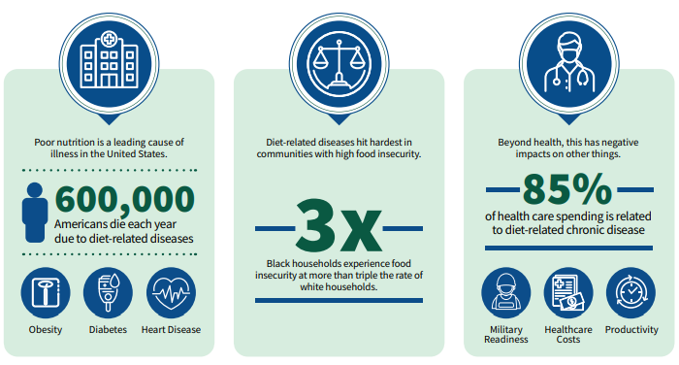
The Consequences have caught up with Americans’
health and economy.
Notes:
Today, nearly three in four adults in the United States have overweight or obesity, and one in two have diabetes or prediabetes.
one in three Americans aged 17 to 24 ineligible for military service due to obesity.
one in four adolescents have prediabetes, one in four have overweight or obesity, and one in six have diet-related fatty liver disease.
Health care spending accounts for 20% of U.S. gross domestic product (GDP) and 29% of federal spending—with 90% of this spending being for chronic conditions.
The direct and indirect health-related costs of hunger and food insecurity in were estimated to be $160 billion in 2014.
The annual U.S. medical costs related to obesity are $173 billion, and type 2 diabetes accounts for 25% of all health care spending.

Slide 11
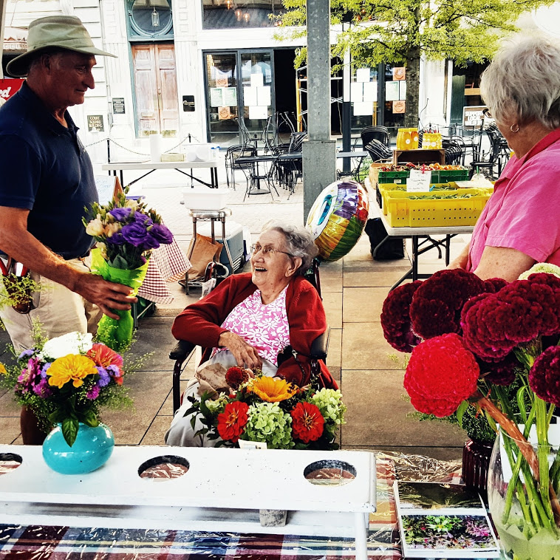
Kentucky Nutritional Health Statistics
31% of adult Kentuckians are obese
66% of adult Kentuckians are overweight
24% of adult Kentuckians consume the recommended amount of fruits and vegetables.
Kentucky children rank #1 in obesity

Slide 12
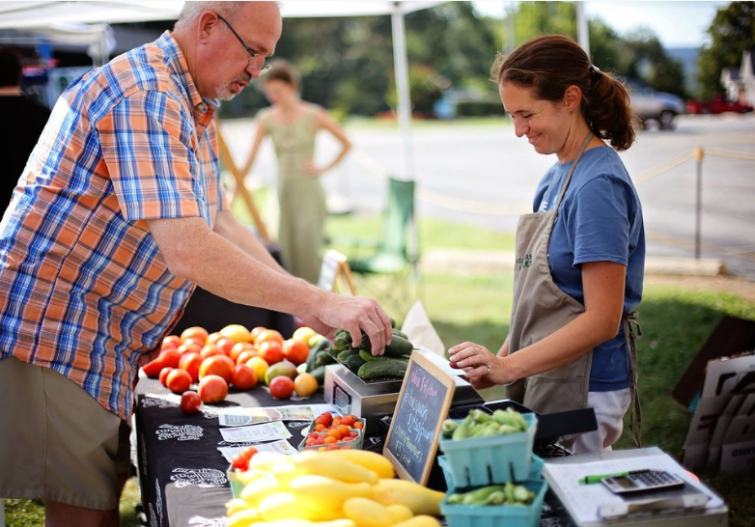
Kentucky Health Outcomes
Kentucky ranks:
48th for cardiovascular disease
44th for diabetes
45th for obesity
43rd for diet related health outcomes

Slide 13
“Food Is Medicine”
Widespread and equitable access to evidence-based, culturally appropriate, and community-centered nutrition interventions in the context of health care.
Medically Tailored Meals
Food Assistance
Incentives for Produce
Based on a Harvard Center for Health Law and Policy Innovation review of ALL the published, peer-reviewed literature, these three interventions are replicable and scalable, but also effective. They are associated with reduced food insecurity, improved dietary intake, and improved participant mental health.

Slide 14
Improved public health is economic
development!
The Economic Impact
Improved food access is economic development!
Every $1 spent on:
Wellness programs saves $3.27 in medical costs and $2.73 in absenteeism costs.
Nutritional and physical activity programs saves $1.17 in medical expenses.” 2010 Harvard wellness program study
Moody's Analytics found that food stamps were the most effective, increasing economic activity by $1.73 for every dollar spent
In 2021 ROI of KADF funds for Kentucky Double Dollars was $8.18 to $1.00

Slide 15
What Can We Do?

Slide 16
Healthy Farm & Food Innovation Fund

Slide 17
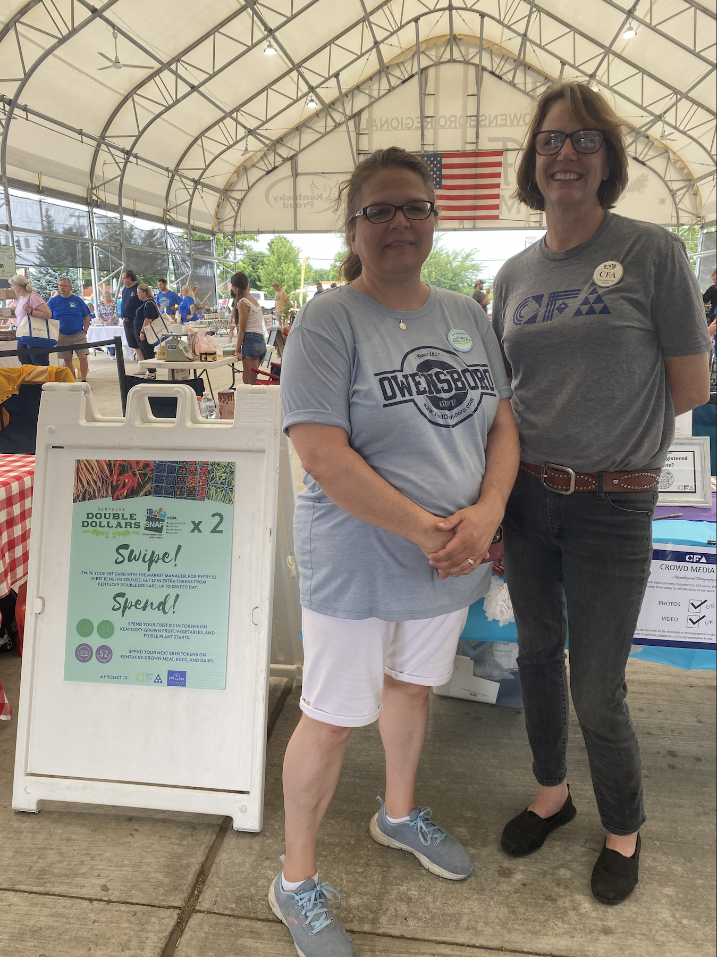
What Is HFFIF?
PRIORITY #1
Used to house matching funds for federal grant programs.
The Healthy Farm and Food Innovation Fund would create a structured state fund capable of receiving state, federal, and private philanthropy funds to help Kentucky address food and nutritional security .
This fund would specifically match grants for programs that help:
Farmers
Local Producers
Seniors
Children and WIC participants
SNAP participants
Applicants to the fund are required to use KY grown products, helping put money back into the pockets of farmers and expanding their businesses.
Notes:
Add flood/disaster relief

Slide 18
What Kinds of Programs Apply?
Kentucky Double Dollars incentivizes the purchase of Kentucky produced fruits and vegetables, meat, eggs, and dairy by SNAP, WIC, and Seniors participants.
70 participating outlets in 2022
Fresh Rx for MOMs is fruit and vegetable prescription (FV Rx)program for Mothers on Medicaid.
11 participating farmers markets in 2022

Slide 19
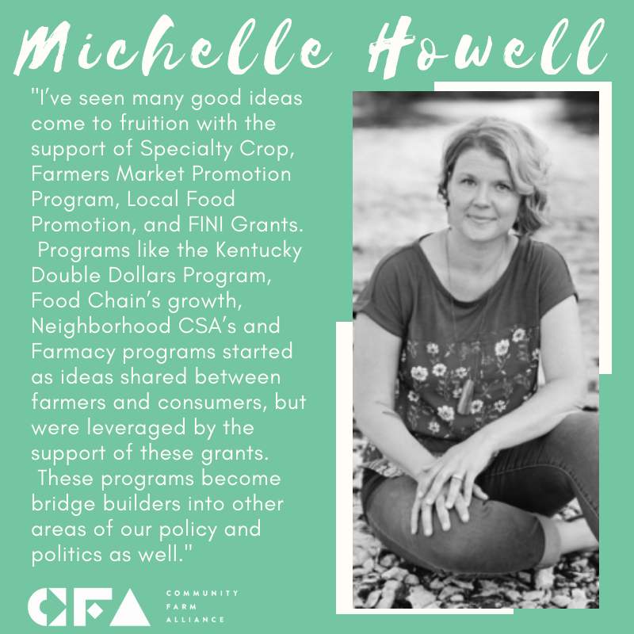
The Impact of HFFIF
For farmers: These programs grow their businesses through increased sales from new and repeating customers who otherwise would not be able to afford locally-grown food.
For families and communities: By increasing the accessibility of healthy locally-grown foods, there will be a decrease household food insecurity and simultaneously improve dietary health outcomes.
For the economy: This fund will bring more federal dollars flowing into the state, increasing the amount of money in Kentucky farmers’ pockets and keeping more dollars local.

Slide 20
Thank You!

Slide 21
Questions?

