Slide 1
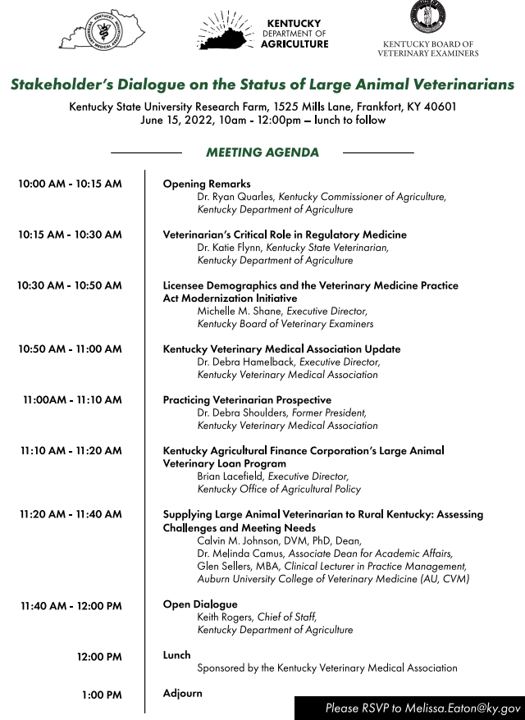

Slide 2
Importance of Veterinarians in Regulatory Medicine
Dr. Katie Flynn
State Veterinarian
Office of State Veterinarian
Kentucky Department of Agriculture

Slide 3
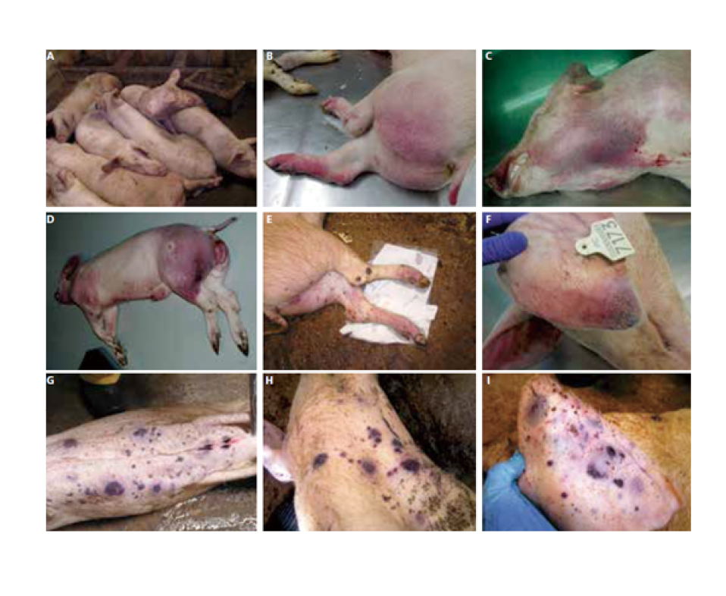
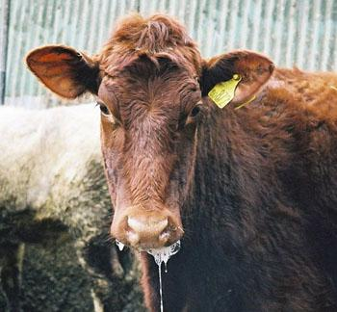
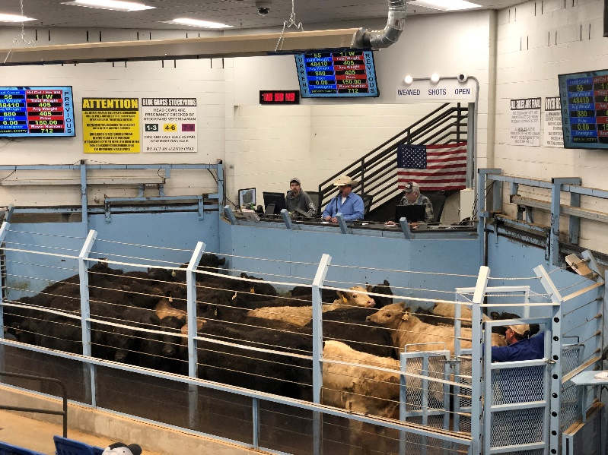
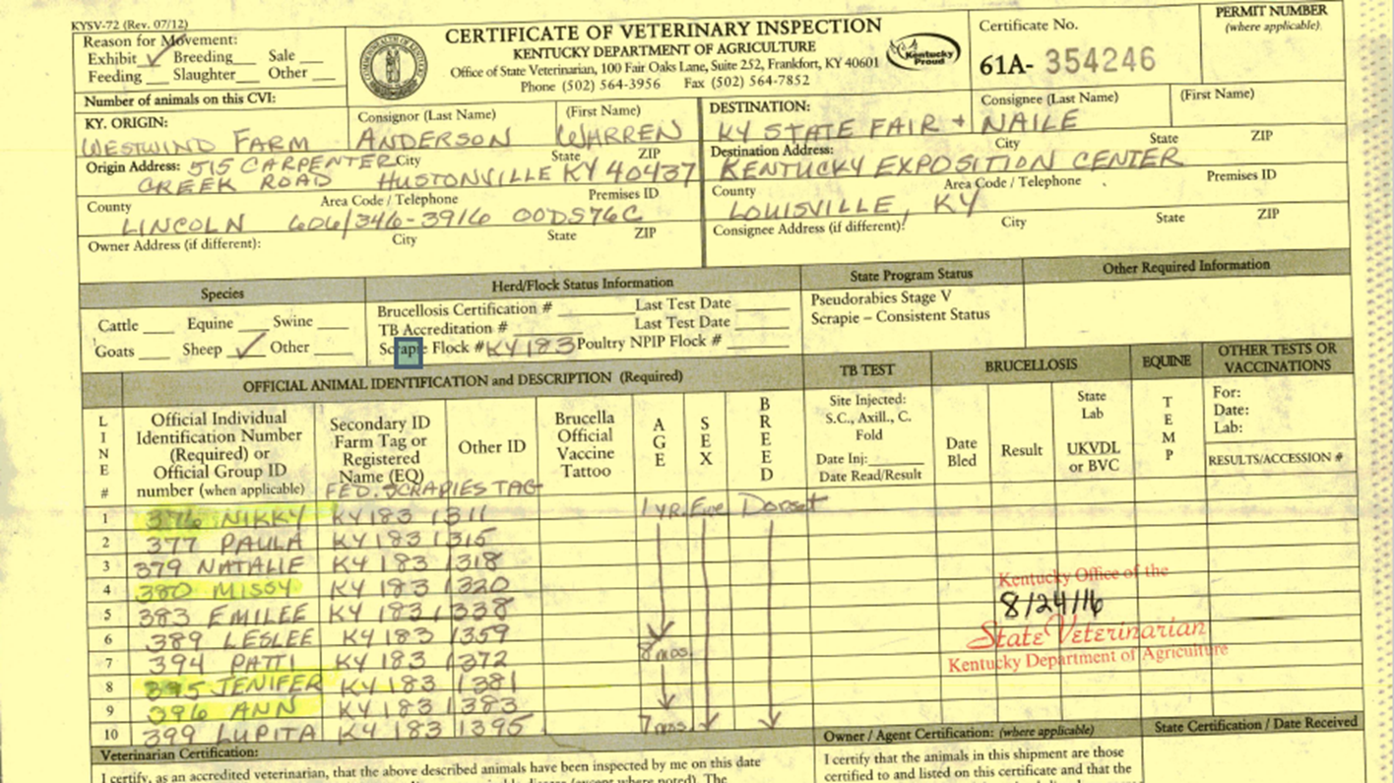
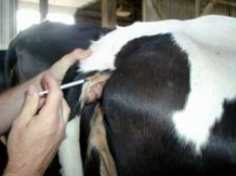
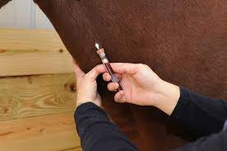
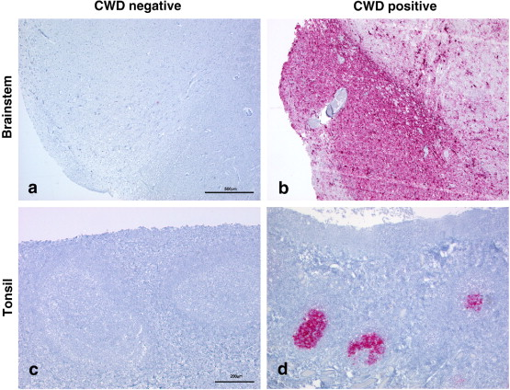
Private Practitioners
Critical Role Protecting Food Supply
Bullet 1
  Subbullet 1

Slide 4
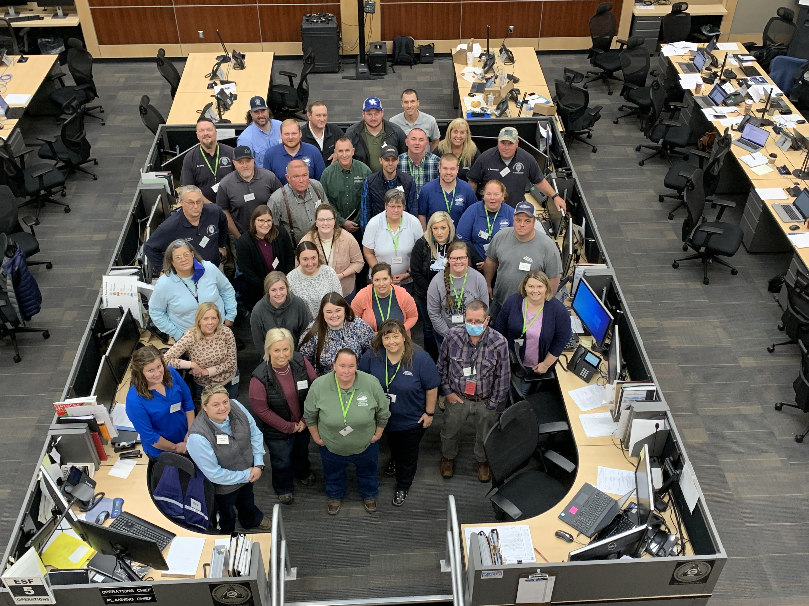
State Animal Health Officials
Critical Preparedness and Response
Veterinary Expertise
  Epidemiology
    Risk Assessments
    Modeling and Planning
  Grant Writing and Coordination
  Outreach and Education
    Veterinarians, Producers, Stakeholders
Emergency Preparedness and Response
  Foreign Animal Disease Response Plans
  Foot and Mouth Disease Vaccination Plans
  Depopulation and Disposal Planning
  Secure Food Supply Planning
  Training and Exercise of Staff

Slide 5
Veterinary Shortages in the Office of State Veterinarian
AUGUST 2021
Kentucky State Fair
SEPTEMBER & OCTOBER 2021
CWD Proximity to Kentucky
NOVEMBER 2021
North American International Livestock Exposition &
Foreign Animal Disease Southern Agriculture Functional Exercise
DECEMBER 2021 & JANUARY 2022
Tornados and Storm Disaster
Response
FEBURARY – APRIL 2022
High Pathogenic Avian Influenza (HPAI)

Slide 6
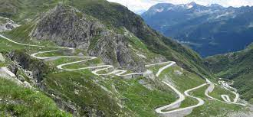
Future of the
Office of State Veterinarian
Increased Staffing
  Fourth Veterinarian
  Emergency Coordinator
  ?????
Grant Funding
  Contract Work
Increase Collaborations

Slide 7

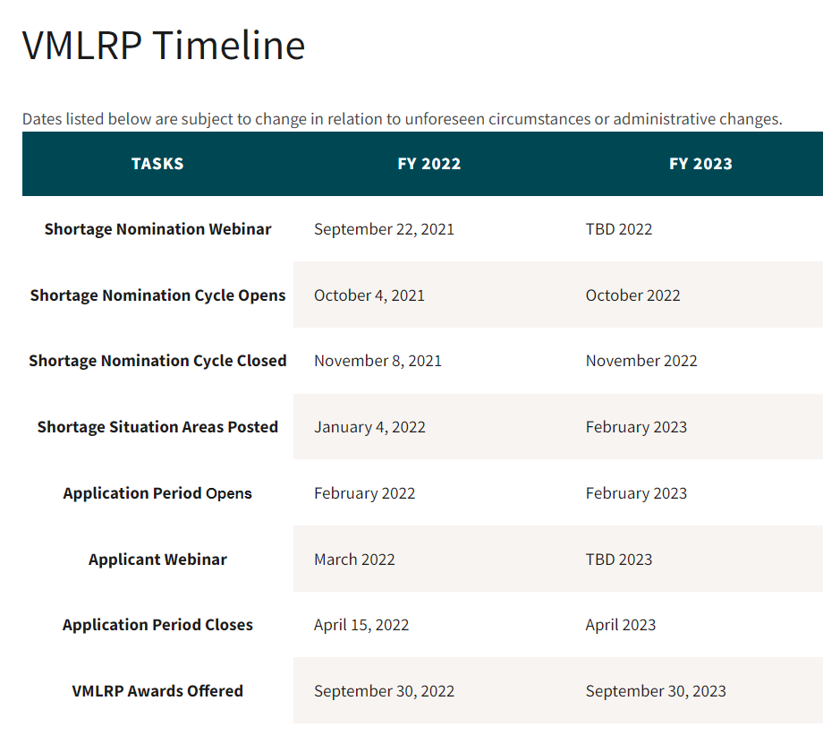
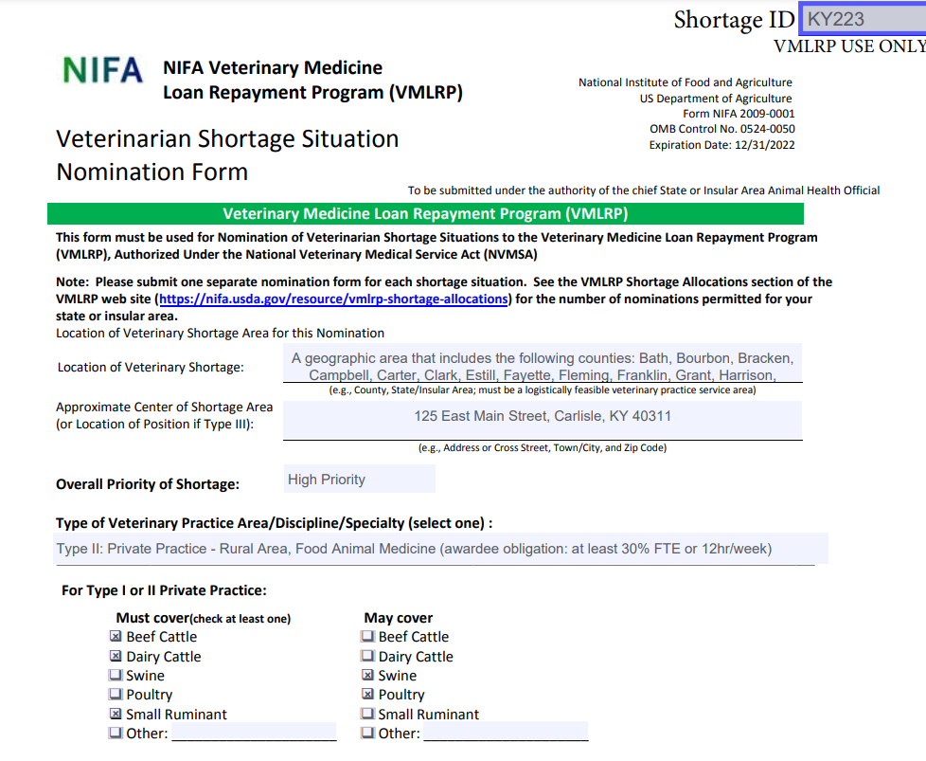
Veterinary Medicine Loan Repayment Program
Year | Awards | Nominations
2021 | 3 | 5
2020 | 2 | 5
2019 | 2 | 5
2018 | 2 | 5
 | 9 | 20

Slide 8


Slide 9
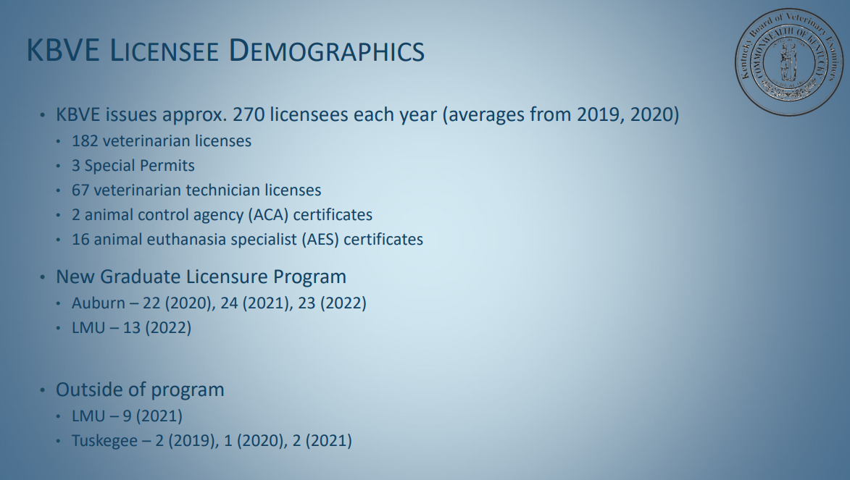

Slide 10
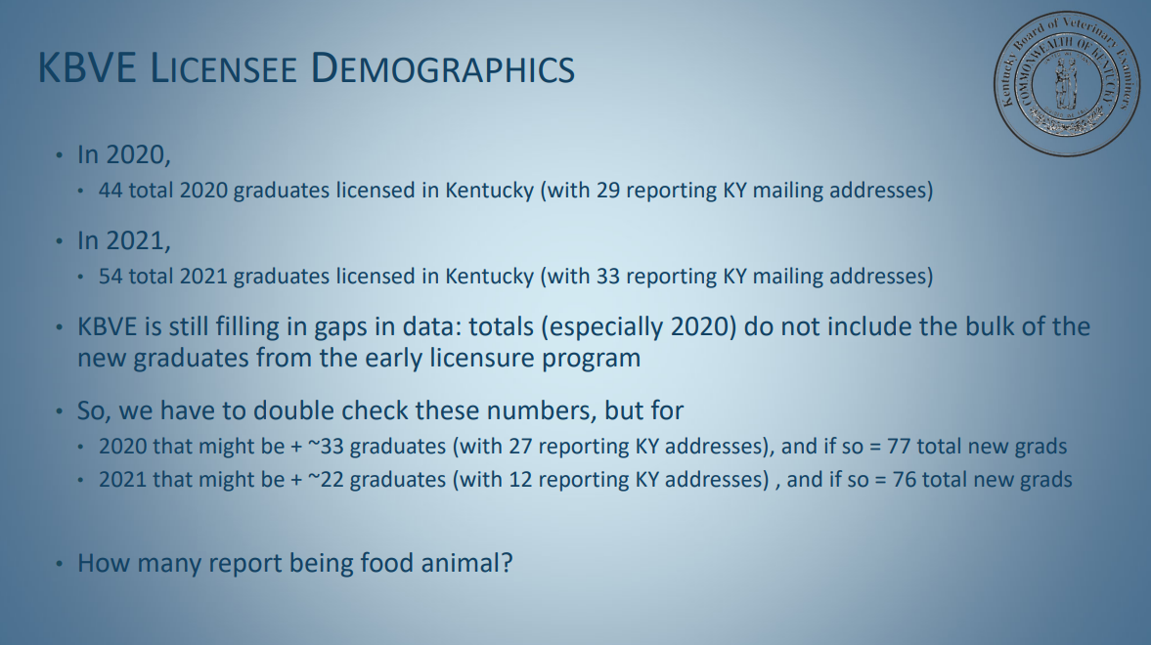

Slide 11
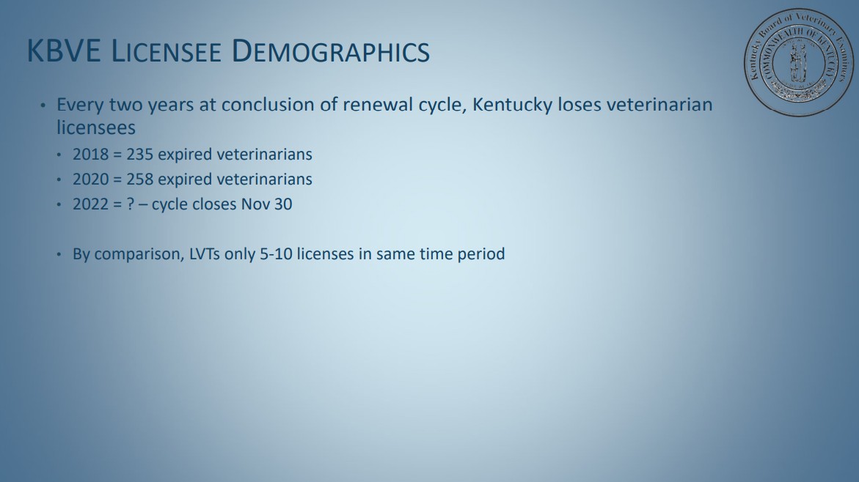

Slide 12
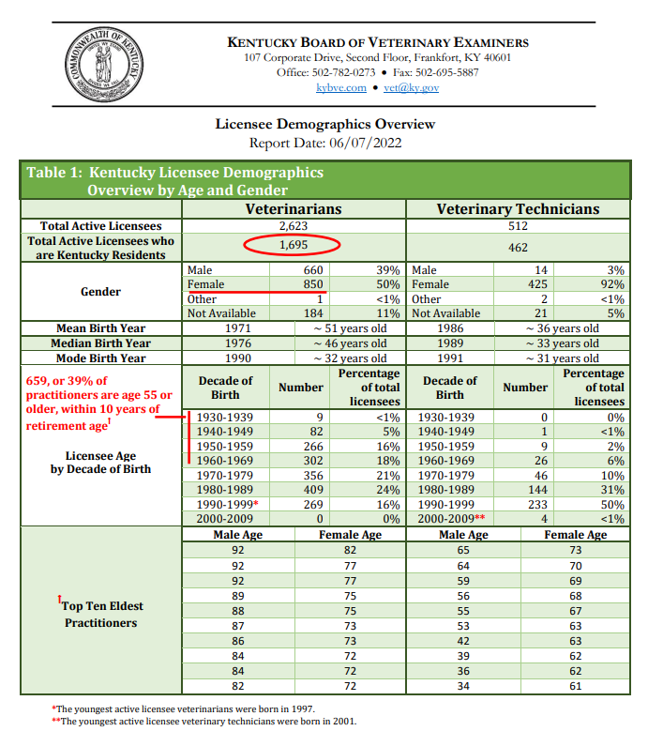

Slide 13
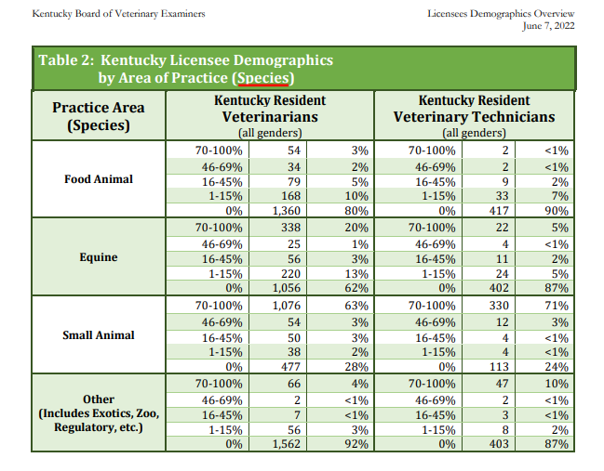

Slide 14
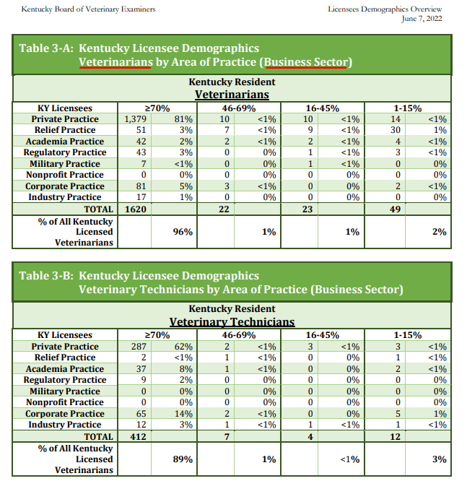

Slide 15
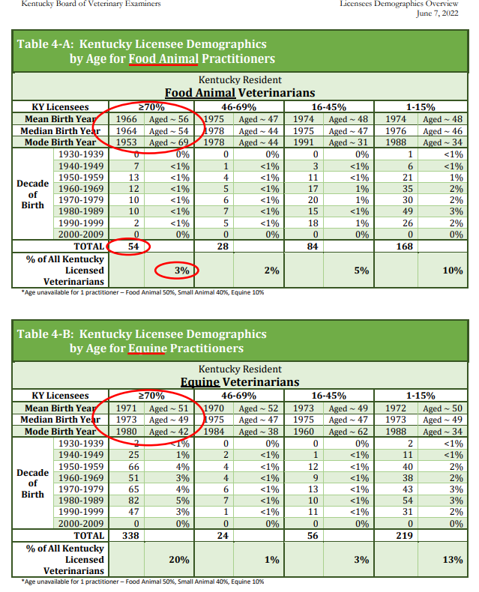

Slide 16
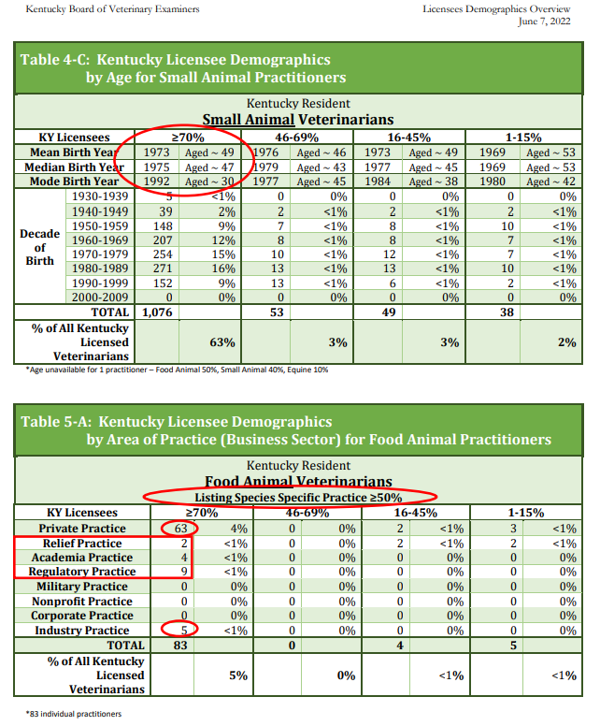

Slide 17
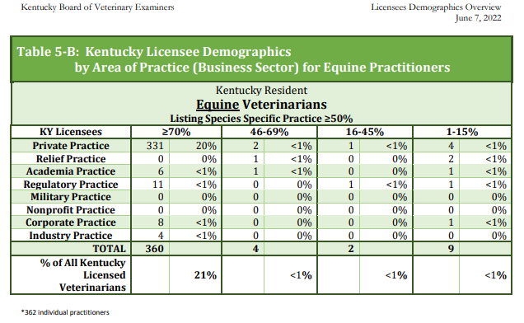

Slide 18
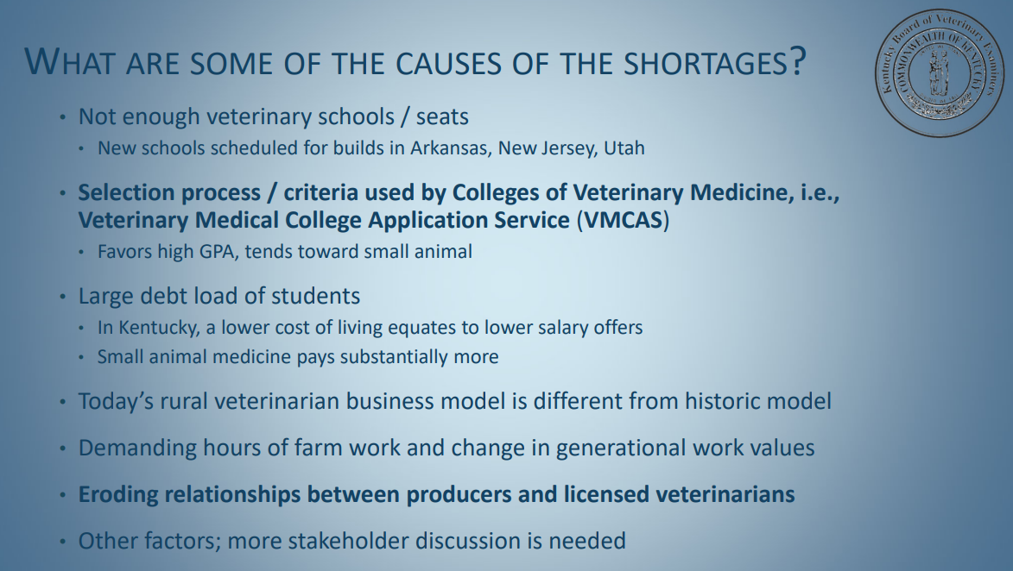

Slide 19
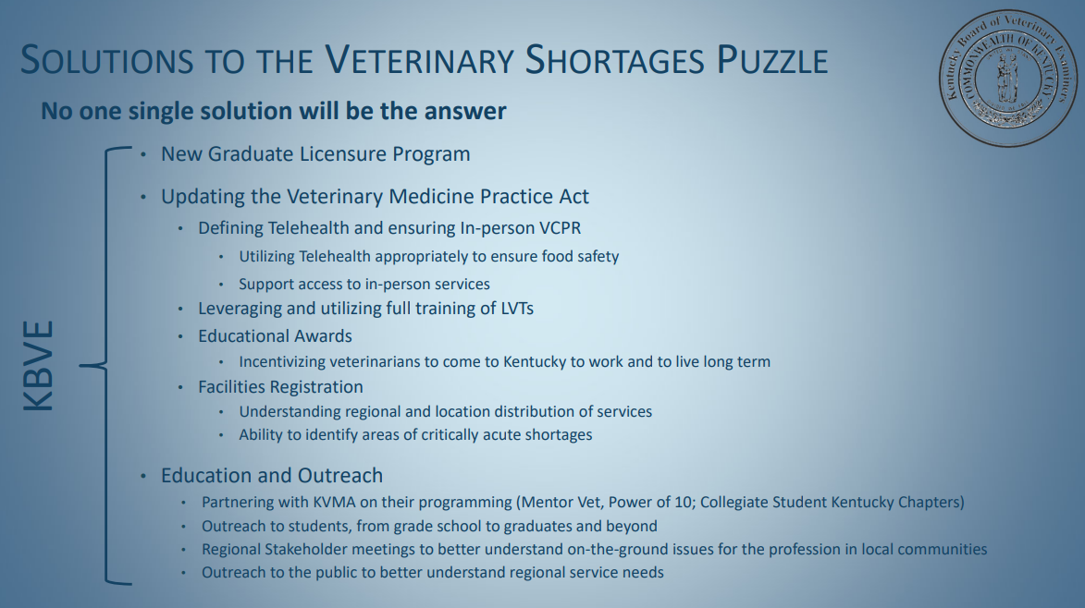

Slide 20
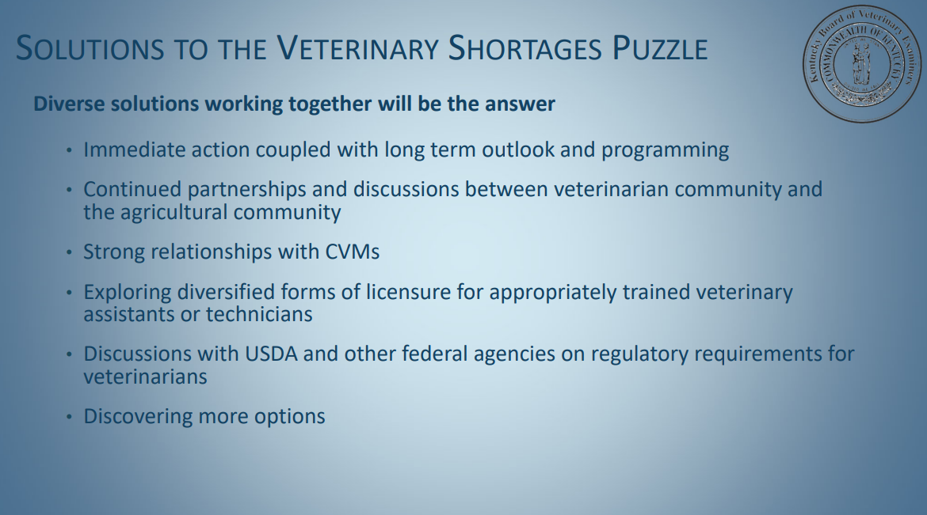

Slide 21



Slide 22
KVMA Mission Statement
To Promote, Protect and Improve the Veterinary Profession.

Slide 23
Advocacy Efforts
Considerable time spent on the veterinary contract spaces. We worked to expand the number of
slots to the current 164 spaces. Full funding for the spaces became a recurrent
battle. Fortunately, we seemed to have overcome that problem—for now
Veterinary reporting of suspected abuse. That was a ten-year battle
Continued support various animal welfare bills over the years
Worked previously with KBVE to make changes to the practice act. One of the more notable changes was adding a veterinary technician to the Board of Examiners.
Worked extensively to provide input on the recent reworking of veterinary regulations
Worked with the Board of Pharmacy to have more veterinary friendly regulations regarding compounded products
Supported and advocated over the years for the removal of livestock drugs from sales tax. This
is finally taking place in January 2023 for livestock except for equine
Successfully worked to remove veterinary reporting requirement to KASPER.

Slide 24
KVMA Programs
Power of Ten Leadership
  Designed for graduates to cultivate leadership capacity in recent graduates and
provide learning experiences that will enrich the individual and benefit the
individual’s practice, community and profession.
  MAVC Conference in kind
    Personality Insights training
  Legislative/Board Meeting Day
  Equine Guided Leadership Training
  Compassion/Treatment Fatigue
  5 days total commitment
  Sponsored by KVMA via scholarship

Slide 25
KVMA Programs
MentorVet
Developed by KVMA Power of Ten Graduate – Dr. Addie Reinhard
6-week program – On – line course that earns 10 CE Race credits
Access to KVMA Mentors and Financial Coaching
Provided by KVMA scholarship with KVMA membership
Oxygen mask program
Veterinary clinics may purchase pet oxygen masks for first responders at your cost.
Over 350 pet animal mask provided to FD and Volunteer FD in the past 2 years.

Slide 26
KVMA Student Chapters
Starting this fall KVMA student chapters will begin at Auburn, Tuskegee and LMU.
Goals
  To develop a relationship with students that would like to return or come to KY to practice veterinary medicine.
  To assist veterinary clinics and students with internships and preceptorships.
  Interactive map that maybe used by veterinarians and students to assist in internships/preceptorships and careers.

Slide 27
KVMA Foundation Mission Statement
“Committed to improving the profession of veterinary medicine by educating the public & developing future leaders in animal industry
through financial assistance.”

Slide 28
KVMA Foundation Goals
Establishing educational funds for veterinary students, veterinarians, and other qualified individuals in the animal industry
Scholarship funds for KY residents at Auburn, Tuskegee, LMU and other accepted CVM’s.
Provide White Coats for Auburn and Tuskegee KY residents.
Provide financial support for FFA, 4-H and other allied groups.
Develop funding sources to sustain the Foundation and its activities.
Emergency relief funds- tornado relief efforts

Slide 29
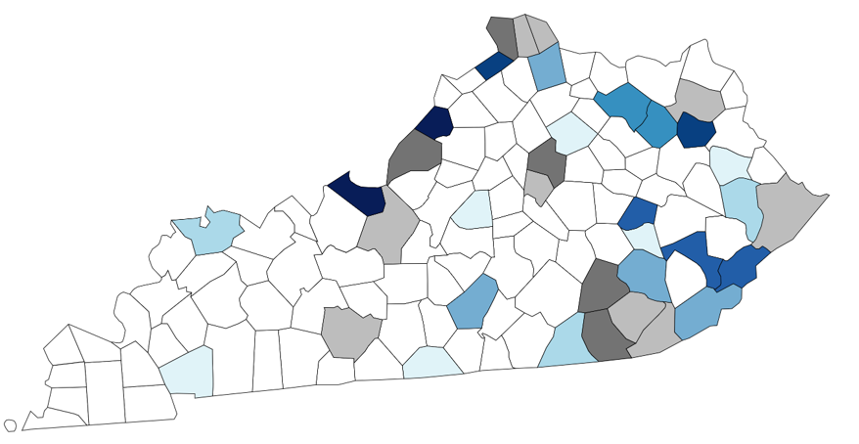












Lincoln Memorial University -
College of Veterinary Medicine
KY STUDENTS (CO2018-CO2024)
University of Kentucky
Lincoln Memorial University
HOME COUNTY KEY
Class of 2024
Class of 2021
Class of 2018
Class of 2023
Class of 2020
2 Classes
Class of 2022
Class of 2019
3 or more Classes
Notes:
Type your notes

Slide 30
LMU Statistics
Kentucky Residents – 67% are from rural backgrounds.
  18 of 27 KY Residents in the first four classes practice in or near their hometown.
  LMU-CVM Class of 2018-2023 average 7-8 KY residents per class – Total of 46.
  Class of 2024 has 21 KY residents
  Class of 2025 has 7 KY residents
2020 Results- LMU grads planned to work in rural communities at a rate of 38.9% versus
the national rate of 20.1%
2021 Results- LMU grads planned to work in rural communities at a rate of 30.0% versus
the national rate of 20.5%

Slide 31

Supplying Large Animal Veterinarians to Rural Kentucky:
Assessing the Challenges and Meeting the Needs

Slide 32

Current Auburn University
College Veterinary Medicine Students
Class of 2022 Ky Jobs
35/119 (29%) Entire class desire a job in KY
35/38 (92%) KY pool desire a job in KY
12/35 (29%) have found a job at graduation
29/35 (83%) applied for KY licensure

Slide 33
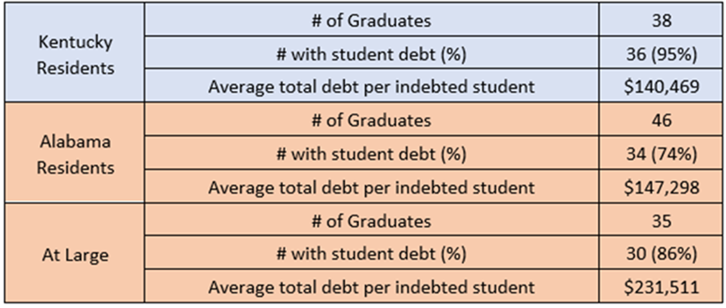
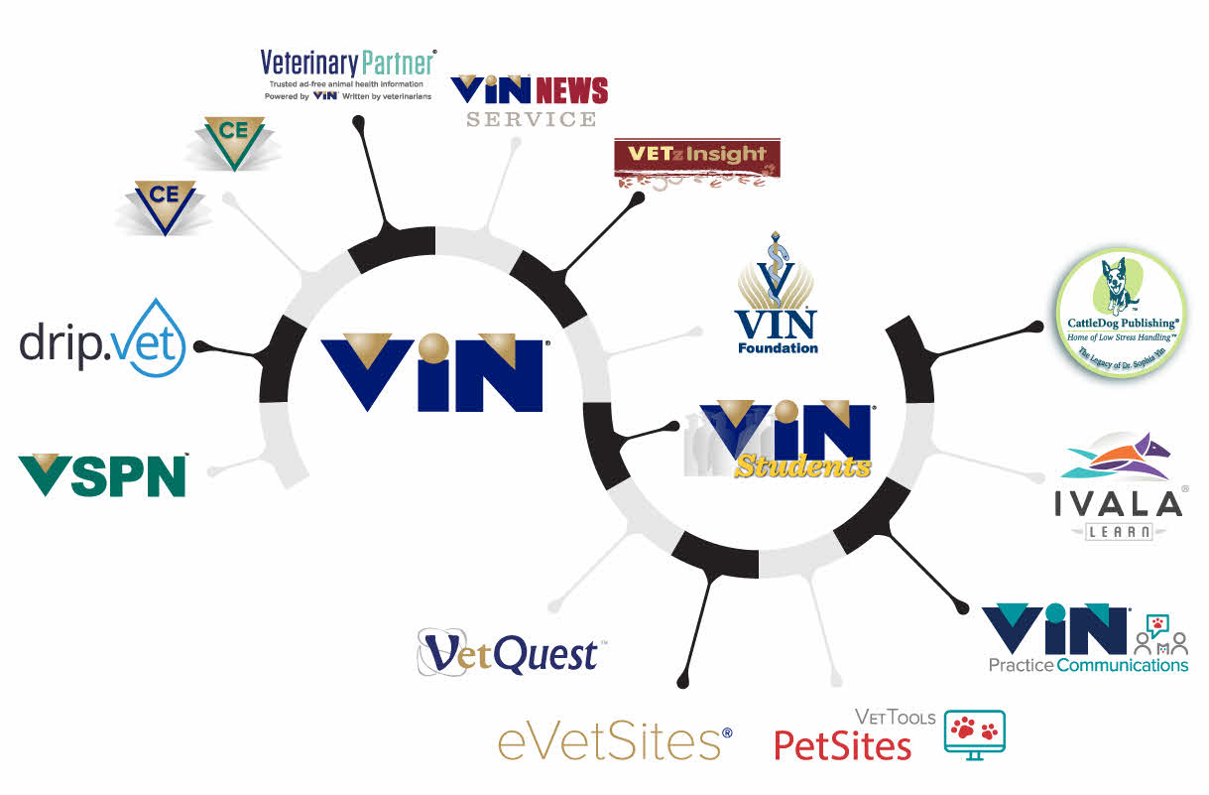
AU Federal Student Debt – Class of 2022
Veterinary Information Network (VIN)
National Student Debt Average for Class of 2022
$218,479

Slide 34

Salaries
AVMA Salary Estimator for Mixed Animal for KY:
Avg $ 81,773 with a range of $73,824 - $89,721

Slide 35
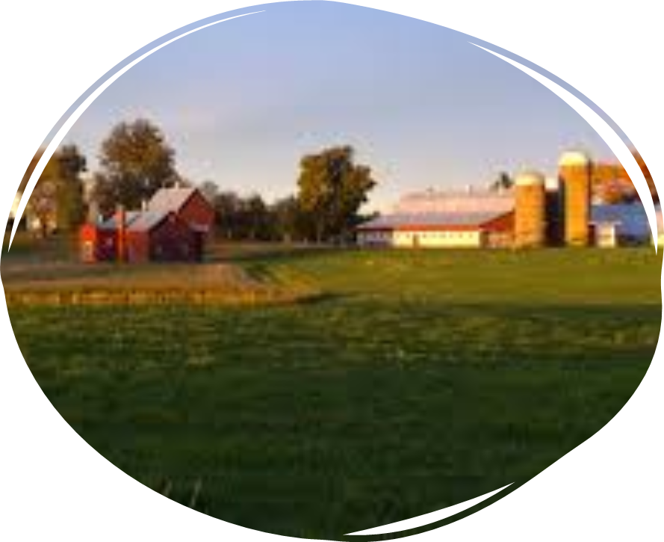
Rural Veterinary Medicine Challenges
Rural practices are different business operations
  Higher caseloads & workloads
  Life balance
  Expanding service areas
  Longer hours
  Lower salaries
  Higher educational debt loads
  Young associates leave rural practice after less than 5 yrs. (Andrus et al. JAVMA 2006)

Slide 36


Rural Veterinary Medicine Challenges
AU College of Veterinary Medicine
USDA NIFA Grant Support
  CE for rural veterinarians
  Connect rural veterinarians with veterinary students
  Externship & Preceptorship opportunities
  Practice management rotation
  Provide a business management assessment and report
  Facilitate a capstone educational experience and networking opportunity
Ph.D. investment in rural practice profitability

Slide 37
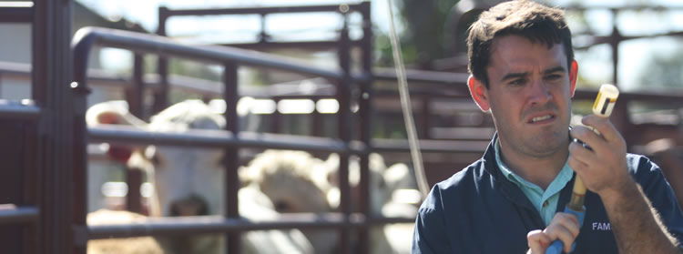
AUCVM Externship & Preceptorship
20 Externships – 2 weeks of experience
  Networking and learning opportunity
  2 didn’t do a rural preceptorship but accepted rural jobs in KY
20 Preceptorships – 8 weeks of experience
  95%* of the preceptors accepted jobs in rural practice
    *1 student has a military commitment but plans to work in rural practice
  15 accepted jobs in rural KY
  Others are in rural AL, IL, FL & GA
  2 of the 20 are now owners in rural practice (KY & GA)

Slide 38

AUCVM Practice Management
47 Clinic visits
21 Hospital assessments
14 Different counties in rural KY designated as shortage areas
Data collected has set up the Ph.D.
Identified new challenges

Slide 39

AUCVM Practice Management
What Has Been Learned
Decreased Profitability
  Unbalanced revenue centers (accounting or operations-Prof Serv)
  Poor price structure
  High cost of goods sold
Higher caseloads vs dollars generated via production numbers
  Doctor transaction
  Hospital transaction
Lower salaries via payroll adding to labor shortages
Area Demographics
  Disposable income
  Household incomes
  Population
Owner Exit Strategies

Slide 40



Potential Solutions
Attract students into rural areas
Determine predictors for rural practice entry
Conditional SREB contract seats
Auburn Practice Management Rotation Support

